Slide 1
Digital Portfolio
STUDENT NAME SEMBARUTHI .E
REGISTER NO AND NMID: 24134121802522031 and autanm41241224ucsc033
DEPARTMENT: B.sc computer science
COLLEGE: COLLEGE/ UNIVERSITY
Kalaimagal colegeof ats and science /annamalai University

Slide 2
PROJECT TITLE
A
STUDENT PORTFOLIO WEBSITE

Slide 3


AGENDA
Problem Statement
Project Overview
End Users
Tools and Technologies
Portfolio design and Layout
Features and Functionality
Results and Screenshots
Conclusion
Github Link
3/21/2024 Annual Review

Slide 4

PROJECT OVERVIEW
🔹 Project Overview Template
1. Title & Thumbnail
Project name + a hero image or mockup.
2. Basic Info (quick-scan section)
Client / Company / Personal project
Role (Designer, Researcher, Developer, Photographer, etc.)
Timeline (Duration or dates)
Tools used (Figma, Photoshop, Python, etc.)
3. Brief Description
A short paragraph (2–4 sentences) summarizing the project’s purpose.
4. Objective / Problem Statement
What challenge were you solving?
Why was this project needed?

Slide 5

WHO ARE THE END USERS?
These are the people who will use/read your portfolio to make decisions about you:
Recruiters & Hiring Managers → want to quickly judge your skills and fit.
Clients → want to see if your style/approach matches their needs.
Collaborators / Agencies → may check your portfolio to assess if you can work together.
Educators / Mentors (if student) → use it to evaluate growth, process, and creativity.

Slide 6

TOOLS AND TECHNIQUES
For a software app, the end user is the person who runs and uses the app on their device.
For a medical device, the end user might be a doctor, nurse, or patient depending on who actually uses it.
For consumer goods, the end user is simply the customer who consumes or uses the product.

Slide 7
POTFOLIO DESIGN AND LAYOUT
Grid Layout → Thumbnails of projects in a neat grid (visual-first).
Single Project Focus → Big hero section with one featured work at a time.
Minimalist Layout → Lots of whitespace, small text, bold visuals.
Interactive Layout → Hover effects, animations, scroll-triggered transitions.
Magazine Style → Editorial-inspired, text + visuals blended.
7

Slide 8
FEATURES AND FUNCTIONALITY
A software product (like an app, website, or tool)?
A device (like a phone, smartwatch, or IoT gadget)?
A document (like a requirements list or product specification)?
Or something else?

Slide 9
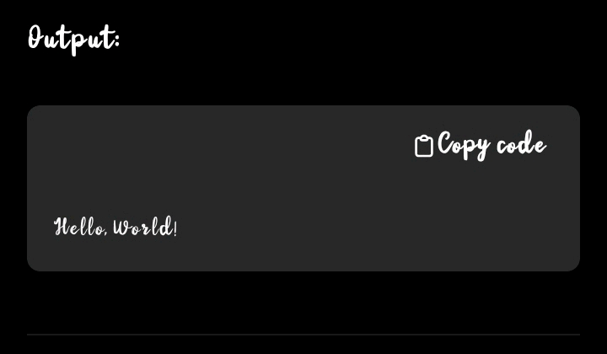

RESULTS AND SCREENSHOTS
Hello, World!
3/21/2024 Annual Review
9

Slide 10
CONCLUSION
A well–designed portfolio is more than just a collection of work — it’s a storytelling tool that communicates your skills, creativity, and professional identity. By combining a clear structure (introduction, projects, case studies, contact), thoughtful design (consistent typography, color palette, and layout), and practical functionality (easy navigation, interactivity, shareability), you create a portfolio that is both visually striking and user-friendly.
10

